Slide 1


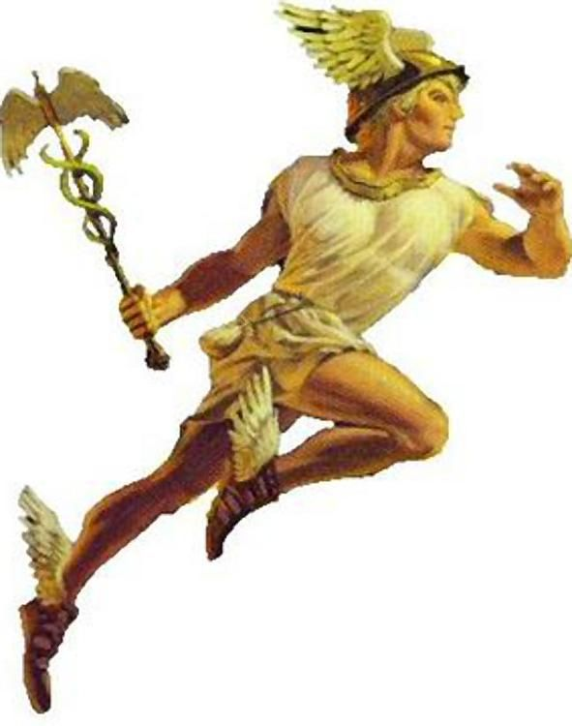







ETL model
Load
Generate
hermesql
Generate
Power BI
SQL
SQL
Excel
Data warehouse
ETL
tabint

